Slide 1
OpenMP Part 2
WorkSharing, Schedule, Synchronization and OMP best practices

Slide 2
Recap of Part 1
What is OPENMP?
Fork/Join Programming model
OPENMP Core Elements
#pragma omp parallel OR Parallel construct
run time variables
environment variables
data scoping (private, shared…)
work sharing constructs
#pragma omp for
sections
tasks
schedule clause
synchronization
compile and run openmp program in c++ and fortran

Slide 3
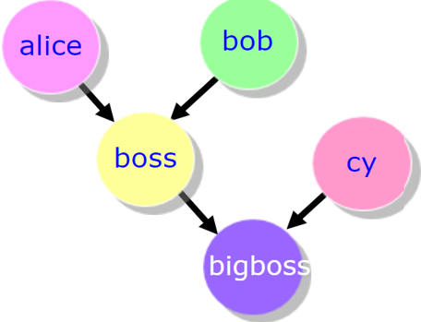
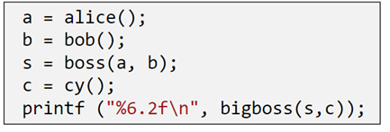
Work Sharing: sections
SECTIONS directive is a non-iterative work-sharing construct.
It specifies that the enclosed section(s) of code are to be divided among the threads in the team.
Each SECTION is executed ONCE by a thread in the team.
Notes:
Exploit Functional Level Parallelism with Work Sharing (SECTIONS)

Slide 4
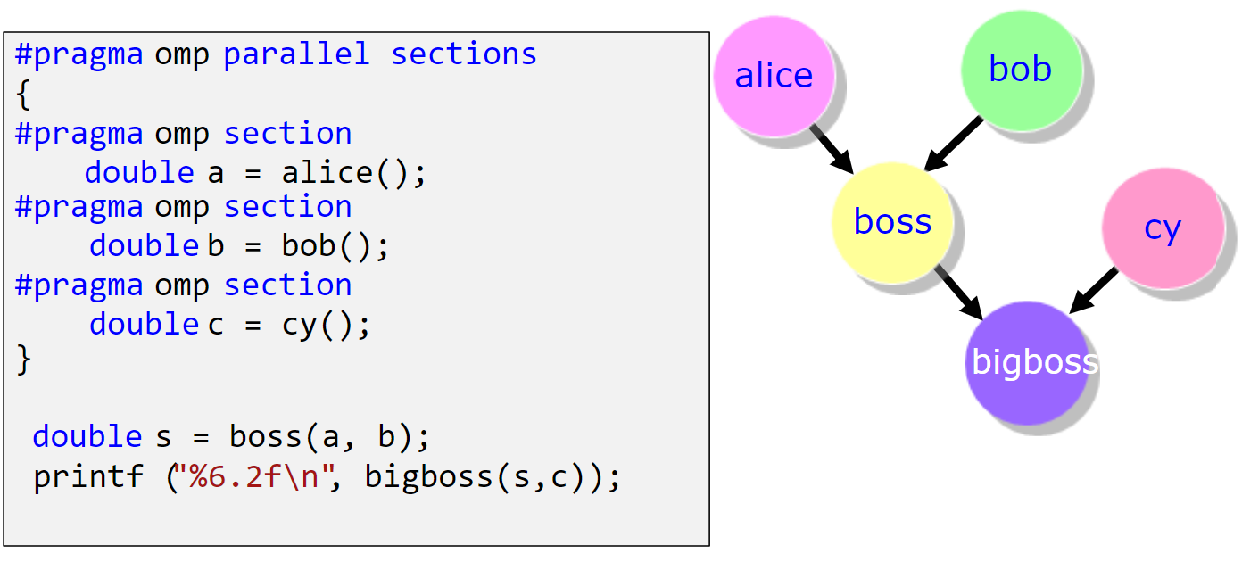
Work Sharing: sections
Notes:
Exploit Functional Level Parallelism with Work Sharing (SECTIONS)

Slide 5
OpenMP: lastprivate Clause - review
!$OMP DO PRIVATE(I) LASTPRIVATE(B)
DO i = 1, 1000
B = i
ENDDO
!$OMP END DO
!—value of B here is 1000
!$OMP SECTIONS LASTPRIVATE(B)
!$OMP SECTION
B = 2
!$OMP SECTION
B = 4
!$OMP SECTION
D = 6
!$OMP END SECTIONS
Creates private memory location for each thread.
Does not initialize the private variable.
The sequentially last iteration of the associated loops, or the lexically last section construct [...] to the original list item.

Slide 6
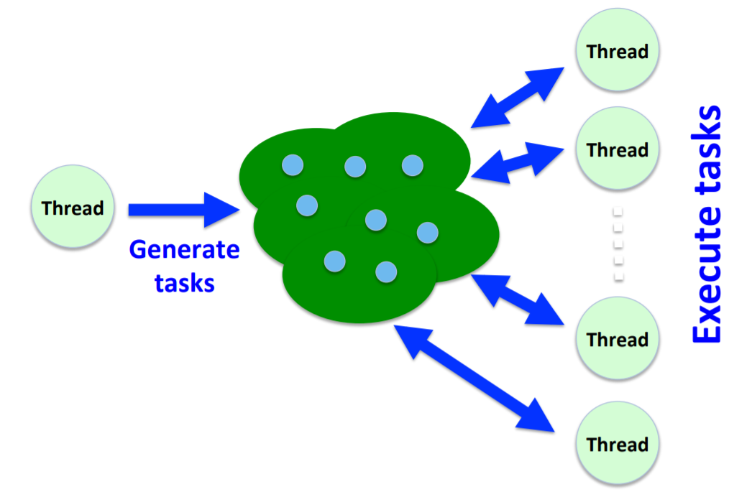
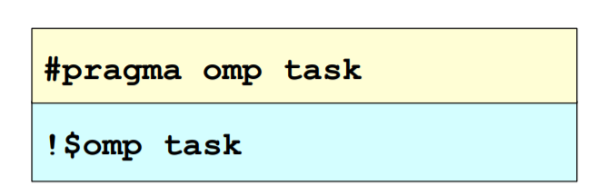
On encountering a task construct, a new task is generated.
Unlike sections, the moment of execution of any task is upto the runtime system and is non-deterministic.
Work Sharing: tasks
Notes:
Exploit Functional Level Parallelism with Work Sharing (SECTIONS)

Slide 7
Work Sharing: tasks
#pragma omp task [clauses]……
Tasks allow to parallelize irregular problems (Unbounded loops & Recursive algorithms )
A task has - Code to execute – Data environment (It owns its data) – Internal control variables – An assigned thread that executes the code and the data
Each encountering thread packages a new instance of a task (code and data)
Some thread in the team executes the task at some later time
All tasks within a team have to be independent and there is no implicit barrier.
Notes:
Exploit Functional Level Parallelism with Work Sharing (SECTIONS)

Slide 8
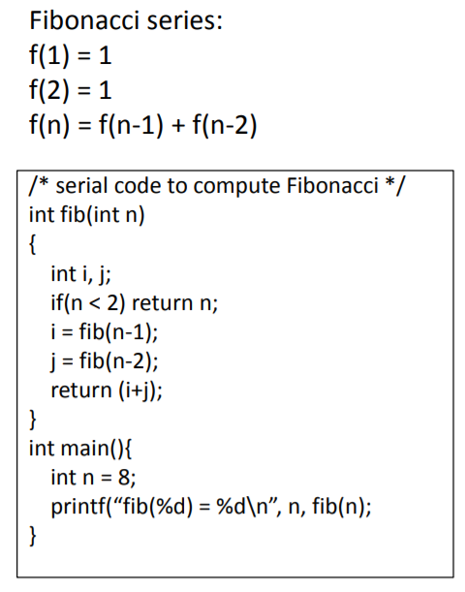
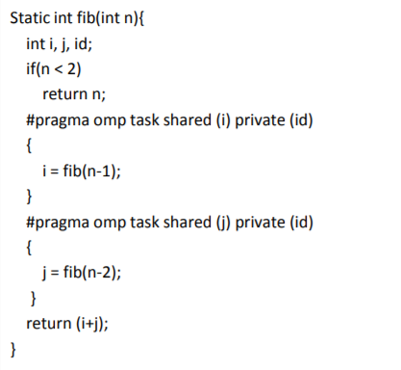
Work Sharing: tasks
Task1
Task2
No implicit barrier
USE #pragma omp taskwait
Notes:
Exploit Functional Level Parallelism with Work Sharing (SECTIONS)

Slide 9
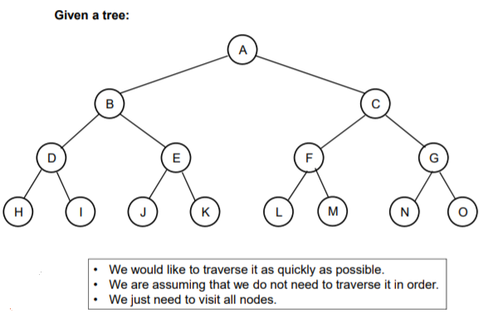
Work Sharing: tasks
Notes:
Exploit Functional Level Parallelism with Work Sharing (SECTIONS)

Slide 10
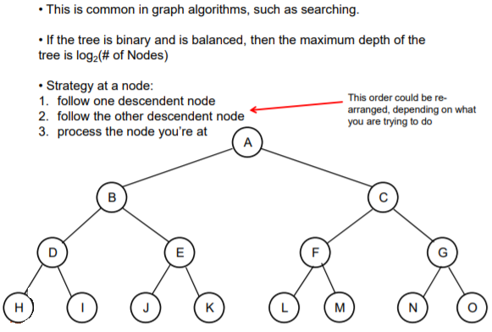
Work Sharing: tasks
Notes:
Exploit Functional Level Parallelism with Work Sharing (SECTIONS)

Slide 11
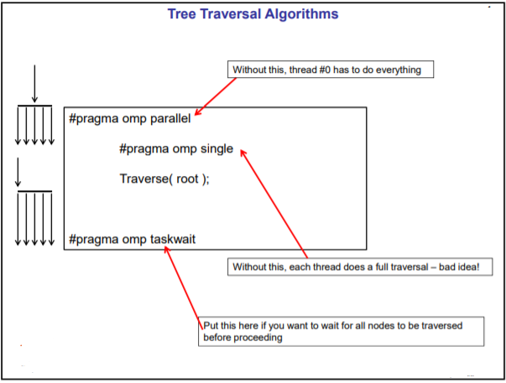
Work Sharing: tasks
Notes:
Exploit Functional Level Parallelism with Work Sharing (SECTIONS)

Slide 12
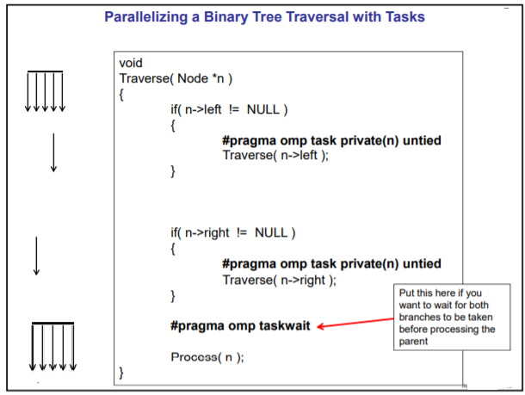
Work Sharing: tasks
Notes:
Exploit Functional Level Parallelism with Work Sharing (SECTIONS)

Slide 13
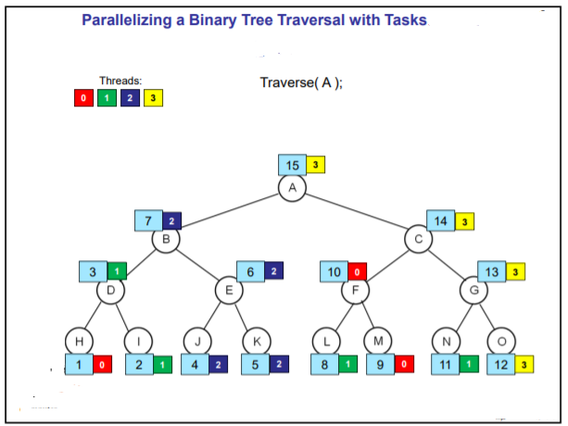
Work Sharing: tasks
Notes:
Exploit Functional Level Parallelism with Work Sharing (SECTIONS)

Slide 14
Work Sharing: single
The SINGLE directive specifies that the enclosed code is to be executed by only one thread in the team.
May be useful when dealing with sections of code that are not thread safe (such as I/O)
!$OMP SINGLE [clause ...]
PRIVATE (list)
FIRSTPRIVATE (list)
block
!$OMP END SINGLE [ NOWAIT ]
#pragma omp single [clause ...] newline private (list) firstprivate (list) nowait structured_block
Notes:
Exploit Functional Level Parallelism with Work Sharing (SECTIONS)

Slide 15
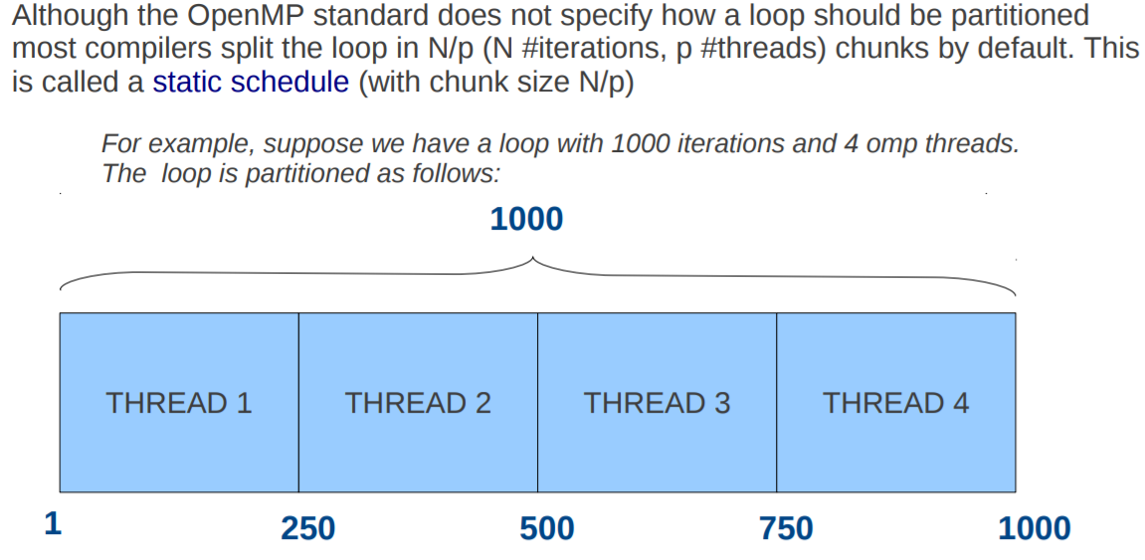
Schedule Clause
How is the work is divided among threads?
Directives for work distribution
Notes:
Static: Pre-determined and predictable by the programmer
Dynamic: Unpredictable, highly variable work per iteration
Guided: Special case of dynamic to reduce scheduling overhead
Way in which parallel loop iterations are distributed among the threads
Depends upon whether each loop iteration yields the same amount of work
Schedule clause schedule(type[, chunk_size])
Static schedule - each thread is assigned a fixed number of chunks (default)
Chunks are groups of iterations (in contiguous order) that are assigned to threads
Dynamic schedule - each thread grabs "chunk" iterations until all iterations are done
Faster threads are assigned more iterations
Interleaved is when chunks are assigned to the processors in a round-robin manner
Guided is a variant of dynamic scheduling where successive chunks get smaller
Runtime is determined at runtime and set by a environment variable

Slide 16
Schedule Clause: Types
A schedule kind is passed to an OpenMP loop schedule clause:
Provides a hint for how iterations of the corresponding OpenMP loop should be assigned to threads in the team of the OpenMP region surrounding the loop.
Five kinds of schedules for OpenMP loop1:
static
dynamic
guided
auto
runtime
The OpenMP implementation and/or runtime defines how to assign chunks to threads of a team given the kind of schedule specified by as a hint.
Notes:
Static: Pre-determined and predictable by the programmer
Dynamic: Unpredictable, highly variable work per iteration
Guided: Special case of dynamic to reduce scheduling overhead
Way in which parallel loop iterations are distributed among the threads
Depends upon whether each loop iteration yields the same amount of work
Schedule clause schedule(type[, chunk_size])
Static schedule - each thread is assigned a fixed number of chunks (default)
Chunks are groups of iterations (in contiguous order) that are assigned to threads
Dynamic schedule - each thread grabs "chunk" iterations until all iterations are done
Faster threads are assigned more iterations
Interleaved is when chunks are assigned to the processors in a round-robin manner
Guided is a variant of dynamic scheduling where successive chunks get smaller
Runtime is determined at runtime and set by a environment variable

Slide 17
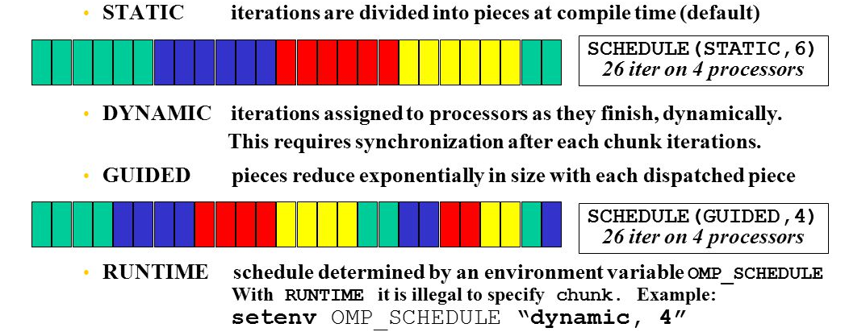
Schedule Clause
Notes:
Static: Pre-determined and predictable by the programmer
Dynamic: Unpredictable, highly variable work per iteration
Guided: Special case of dynamic to reduce scheduling overhead
Way in which parallel loop iterations are distributed among the threads
Depends upon whether each loop iteration yields the same amount of work
Schedule clause schedule(type[, chunk_size])
Static schedule - each thread is assigned a fixed number of chunks (default)
Chunks are groups of iterations (in contiguous order) that are assigned to threads
Dynamic schedule - each thread grabs "chunk" iterations until all iterations are done
Faster threads are assigned more iterations
Interleaved is when chunks are assigned to the processors in a round-robin manner
Guided is a variant of dynamic scheduling where successive chunks get smaller
Runtime is determined at runtime and set by a environment variable

Slide 18
Schedule Clause
STATIC: Iterations of a loop are divided into chunks of size ceiling(iterations/threads). Each thread is assigned a separate chunk.
STATIC, N: Iterations of a loop are divided into chunks of size N. Each chunk is assigned to a thread in round-robin fashion. N >= 1 (integer expression)
DYNAMIC: Iterations of a loop are divided into chunks of size 1.
Chunks are assigned to threads on a first-come, first-serve basis as threads become available. This continues until all work is completed.
DYNAMIC, N: Same as above, all chunks are set to size N
GUIDED: Chunks are made progressively smaller until a chunk size of one is reached. The first chunk is of size ceiling(iterations/threads). Remaining chunks are of size ceiling(iterations_remaining/threads).Chunks are assigned to threads on a first-come, first-serve basis as threads become available. This continues until all work is completed.
GUIDED, N: Minimum chunk size is N
AUTO: Delegated the decision of the scheduling to the compiler and/or runtime system
RUNTIME: Scheduling policy is determined at run time. OMP_SCHEDULE/ OMP_SET_SCHEDULE

Slide 19
OpenMP: Synchronization
The programmer needs finer control over how variables are shared.
The programmer must ensure that threads do not interfere with each other so that the output does not depend on how the individual threads are scheduled.
In particular, the programmer must manage threads so that they read the correct values of a variable and that multiple threads do not try to write to a variable at the same time.
Data dependencies and Task Dependencies
MASTER, CRITICAL, BARRIER, FLUSH, TASKWAIT, ORDERED, NOWAIT
Notes:
Thread 0 is on CPU0 and at the fork 3 new threads are created and distributed to the remaining 3 CPUs

Slide 20
Data Dependencies
OpenMP assumes that there is NO data-dependency across jobs running in parallel
When the omp parallel directive is placed around a code block, it is the programmer’s responsibility to make sure data dependency is ruled out

Slide 21
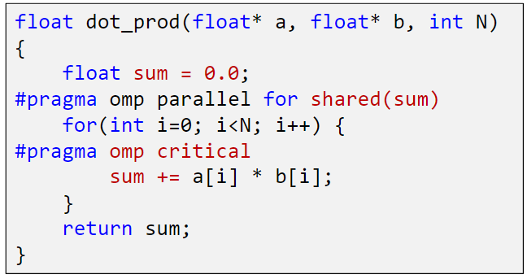
Synchronization Constructs
1) Mutual Exclusion (Data Dependencies)
Critical Sections : Protect access to shared & modifiable data, allowing ONLY ONE thread to enter it at a given time
#pragma omp critical
#pragma omp atomic – special case of critical, less overhead
Locks
Only one thread updates this at a time
Notes:
Synchronization is achieved by mutual exclusion

Slide 22
Synchronization Constructs
To impose order constraints and protect shared data.
Achieved by Mutual Exclusion & Barriers
2) Barriers (Task Dependencies)
Implicit : Sync points exist at the end of
parallel –necessary barrier – cant be removed
for – can be removed by using the nowait clause
sections – can be removed by using the nowait clause
single – can be removed by using the nowait clause
Explicit : Must be used when ordering is required
#pragma omp barrier
each thread waits until all threads arrive at the barrier
Notes:
In the constructs for declaring parallel regions above, you had little control over in what order threads executed the work they were assigned.
synchronization constructs: ways of telling threads to bring a certain order to the sequence in which they do things.
Barrier: Each thread waits until all threads arrive
The single construct denotes a block of code that is executed by only one thread (not necessarily the master thread)

Slide 23
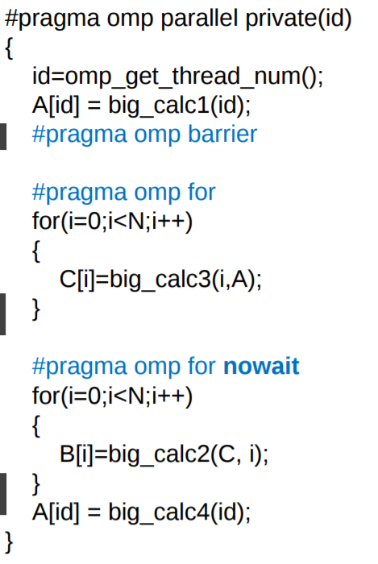
Synchronization: Barrier
Explicit Barrier
Implicit Barrier at end of parallel region
No Barrier nowait cancels barrier creation

Slide 24
OPENMP Synchronization: review
PRAGMA | DESCRIPTION
#pragma omp taskwait !$OMP TASKWAIT | Specifies a wait on the completion of child tasks generated since the beginning of the current task
#pragma omp critical !$OMP CRITICAL !$OMP END CRITICAL | Code within the block or pragma is only executed on one thread at a time.
#pragma omp critical !$OMP ATOMIC !$OMP END ATOMIC | Provides a mini-CRITICAL section. specific memory location must be updated atomically (Atomic statements)
#pragma omp barrier !$OMP BARRIER !$OMP END BARRIER | Synchronizes all threads in a team; all threads pause at the barrier, until all threads execute the barrier.
Notes:
master is very similar to single with two differences:
master will be executed by the master only while single can be executed by whichever thread reaching first the region; and
single has an implicit barrier upon completion of the region, where all threads wait for synchronisation, while master doesn't have any
atomic is very similar to critical, but is restricted for a selection of simple operations

Slide 25
OPENMP Synchronization: review
PRAGMA | DESCRIPTION
#pragma omp for ordered [clauses...] (loop region) #pragma omp ordered structured_block | Used within a DO / for loop Iterations of the enclosed loop will be executed in the same order as if they were executed on a serial processor. Threads will need to wait before executing their chunk of iterations if previous iterations haven't completed yet.
#pragma omp flush (list) | Synchronization point at which all threads have the same view of memory for all shared objects. FLUSH is implied for barrier parallel - upon entry and exit critical - upon entry and exit ordered - upon entry and exit for - upon exit sections - upon exit single - upon exi
Notes:
master is very similar to single with two differences:
master will be executed by the master only while single can be executed by whichever thread reaching first the region; and
single has an implicit barrier upon completion of the region, where all threads wait for synchronisation, while master doesn't have any
atomic is very similar to critical, but is restricted for a selection of simple operations

Slide 26
OpenMP Parallel Programming
Start with a parallelizable algorithm
Loop level parallelism /tasks
Implement Serially : Optimized Serial Program
Test, Debug & Time to solution
Annotate the code with parallelization and Synchronization directives
Remove Race Conditions, False Sharing
Test and Debug
Measure speed-up (T-serial/T-parallel)
Notes:
Coherence: Behavior of the memory system when a single address is accessed by multiple threads
If independent data elements happen to sit on the same cache line, each update will cause the cache lines to “slosh back and forth” between threads.  This is called “false sharing”

Slide 27
Installing and running C/C++/Fortran Programs on multicore machines
The GNU Project https://gcc.gnu.org/install/binaries.html
MacOS:
The Homebrew package manager : https://brew.sh/
MacPorts https://www.macports.org/
MS Windows
The Cygwin project https://sourceware.org/cygwin/
MinGW and mingw-w64 projects http://www.mingw.org/ http://mingw-w64.org/doku.php
Linux machines come pre-installed with gnu binaries
gcc --version
gfortran --version

Slide 28
Environment Variables
LINUX /UNIX bash /Cygwin:
List all environment variables: printenv
Update environment variable : export OMP_NUM_THREADS=5
LINUX/UNIX csh
List all environment variables: printenv
Update environment variable : setenv OMP_NUM_THREADS 5
Windows/DOS
List all environment variables: set
Update environment variable : set (/A) OMP_NUM_THREADS= 5
OSX
List all environment variables: env
Update environment variable : export OMP_NUM_THREADS= 5

Slide 29
Compiling and running OPENMP Code
Locally
$g++ -fopenmp Program.cpp –o <output_name>
$gfortran –fopenmp Program.f95 –o <output_name>
$./<output_name>

Slide 30
OpenMP environment variables
OMP_DYNAMIC : When set to TRUE, the number of threads available for executing parallel regions can be adjusted at run time to make the best use of system resources.
OMP_NESTED: When set to TRUE, nested parallelism is enabled. This means that the runtime environment might deploy extra threads to form the team of threads for the nested parallel region.
OMP_PROC_BIND : When TRUE, binds threads to processors.
OMP_MAX_ACTIVE_LEVELS: The maximum number of active nested parallel regions.
OMP_STACK_SIZE: Specifies the size of the stack for threads that are created by the OpenMP run time. (default in KB). If the compiler cannot deliver the stack size specified by the environment variable, or if OMP_STACKSIZE does not conform to the valid format, the compiler sets the environment variable to the default value.
OMP_WAIT_POLICY: Use ACTIVE if you want waiting threads to mostly be active. That is, the threads consume processor cycles while waiting. For example, waiting threads can spin while waiting. The ACTIVE wait policy is recommended for maximum performance on the dedicated machine. Use PASSIVE if you want waiting threads to mostly be passive. That is, the threads do not consume processor cycles while waiting. For example, waiting threads can sleep or yield the processor to other threads.

Slide 31
OpenMP environment variables
Display OPENMP environment upon execution of the program
$export OMP_DISPLAY_ENV=TRUE (bash)
$setenv OMP_DISPLAY_ENV TRUE (csh)
OPENMP DISPLAY ENVIRONMENT BEGIN
_OPENMP = '201307'
OMP_DYNAMIC = 'FALSE'
OMP_NESTED = 'FALSE'
OMP_NUM_THREADS = '32'
OMP_SCHEDULE = 'DYNAMIC'
OMP_PROC_BIND = 'FALSE'
OMP_PLACES = ''
OMP_STACKSIZE = '140729178218216'
OMP_WAIT_POLICY = 'PASSIVE'
OMP_THREAD_LIMIT = '4294967295'
OMP_MAX_ACTIVE_LEVELS = '2147483647'
OMP_CANCELLATION = 'FALSE'
OMP_DEFAULT_DEVICE = '0'
OPENMP DISPLAY ENVIRONMENT END

Slide 32
Running OpenMP code
Controlling the number of threads at runtime
The default number of threads = number of online processors on the machine.
C shell : setenv OMP_NUM_THREADS number
Bash shell: export OMP_NUM_THREADS = number
Runtime OpenMP function omp_set_num_threads(4)
Clause in #pragma for parallel region
Execution Timing
#include omp.h
stime = omp_get_wtime();
longfunction();
etime = omp_get_wtime();
total = etime-stime;

Slide 33
Compiling and running OPENMP Code
On SahasraT
$ssh <username>@sahasrat.serc.iisc.ernet.in
$password:
Copy the code onto the home area
Create make files for compiling code (clearing binaries, compiling, linking and creating executable)
Run make
Create a job script to submit the job in batch mode
qsub jobscript
qstat
Check output

Slide 34
Exercise1 - HelloWorld
$vi <code>.cpp
$make
$qsub jobscript
$qstat
$vi jobscript
Exercise2 – Schedule Clause
2019SepOPENMP
Exercise 3- Data Scoping
Exercise 4 – Compute PI
Exercise 5 – Matrix Multiplication

